Slide 1
Capstone Option 2: Biodiversity for the National Parks
Chris Green

Slide 2
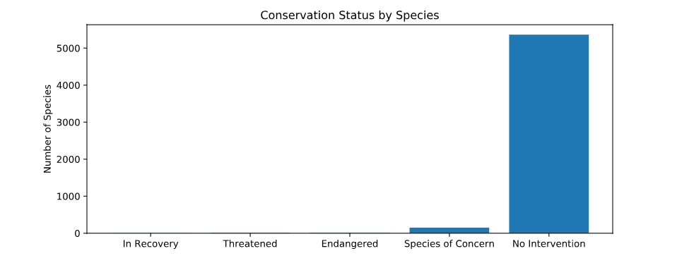
species_info.csv
Species.csv is a csv file which contains a table of data which has a 5,543 records of different species and details the category, scientific name ,common names and conservation status.
From the data we learned that the vast majority of species had ‘no intervention’
No intervention: 5,363
Species of concern: 151
Endangered : 15
Threatened: 10
In recovery: 4

Slide 3
Significance
It seems that some categories of species are more likely that other to require intervention. Mammals most of all.
Running a Chi-Squared Test for Significance we found that there was no significant difference between the likelihood mammals being endangered over birds ( p-value of 0.68) however, there was a significantly greater likelihood that Mammals would be endangered over reptiles ( p-value of 0.04).
Therefore we can conclude that some categories of animals are more likely to be endangered than others.

Slide 4
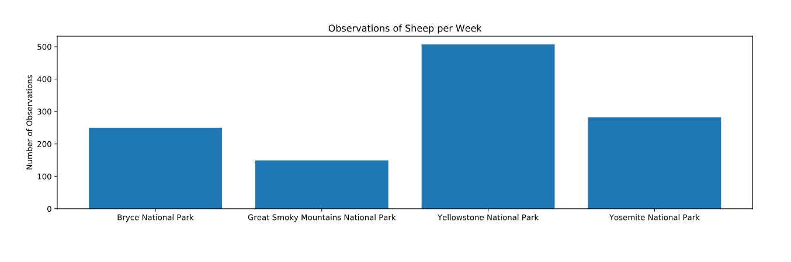
sample size determination
With a baseline 15% occurrence of foot and mouth disease in sheep at Bryce National Park, we found that if the scientists wanted to be sure that a >5% drop in observed cases of foot and mouth disease in the sheep at Yellowstone was significant they would have to observe at least 870 sheep. This would take the scientists approximately 1 week to complete their observation. At Great Smoky this would take 5 weeks and at Yosemite it would take 3 weeks.

